Slide 1





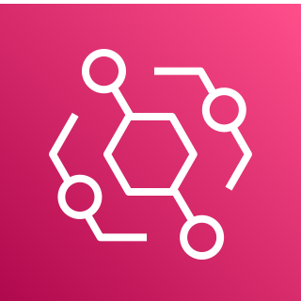











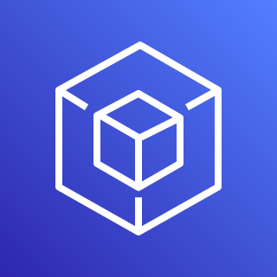

Web App Security
AWS Cloud
Backend Resources
7. Return Token Validity
2. Return Access Token
Cognito User Pool
DynamoDB
Step Functions
Event Bridge
4. Return Temporary Credentials
Cloudwatch
S3 Bucket
SNS
Elastic Container Registry
1. Sign-in
Cognito Identity Pool
3. Provide Identity ID & Token
6. Validate Token & Scope
Lambdas
End users
IAM Policies
5. API Requests with Bearer Authentication in Header
IAM Roles
8. Proxy Requests to Specific Lambdas
9. AWS API Requests
Lambda Functions
API Gateway
*
AWS SDK (Boto3)
Indicates data encrypted at rest with default encryption, KMS, or KMS-CMK deployment options
*
Lambda specific roles provide fine-grained access to backend resources

Slide 2
Web App Security Download/Upload Asset
1-4. Sign-in and get temporary credentials
AWS Cloud
5. S3 API PutObject & GetObject Requests with Bearer Authentication in Header
End users
S3 Asset Bucket Regional Endpoint
Indicates data encrypted at rest with default encryption, KMS, or KMS-CMK deployment options

Slide 3









Web App Network - CF
AWS Cloud
3. Allow or reject traffic
4. Request Website From Origin
Backend Resources
1. Request Website
WAF
CloudFront CDN
S3 Static File Storage
2. Inspect incoming request based on ACL rules.
Region
Web App
4. Load and Render Website
9. Proxy Request
10. AWS API Requests
6. HTTP GET, POST, PUT, DELETE & OPTIONS* Requests
Browser Client
React
Amplify JS Library
API Gateway HTTP v2
Lambda Proxy Integrated Functions
5. Sign-in, authenticate & retrieve credentials
*Not all backend resources pictured
Cognito
* HTTP OPTIONS requests are for CORS preflight check

Slide 4



Web App Network - ALB
AWS Cloud
Region
3. Allow or reject traffic
4. Request Website Through S3 Interface Endpoint
Backend Resources
1. Request Website using custom domain hostname
WAF
Application Load
Balancer
S3 Static File Storage
(Bucket Matches Hostname)
2. Inspect incoming request based on ACL rules.
Region
Web App
4. Load and Render Website
9. Proxy Request
10. AWS API Requests
6. HTTP GET, POST, PUT, DELETE & OPTIONS* Requests
Browser Client
React
Amplify JS Library
API Gateway HTTP v2
Lambda Proxy Integrated Functions
5. Sign-in, authenticate & retrieve credentials
*Not all backend resources pictured
Indicates HTTPS ACM certificate requirement
Cognito
* HTTP OPTIONS requests are for CORS preflight check

Slide 5
Web App Network Download/Upload Asset
AWS Cloud
1-3. Request Website
6. HTTP GET, PUT & OPTIONS* Requests
Region
Web App
4. Load and Render Website
Browser Client
React
Amplify JS Library
S3 Asset Bucket Regional Endpoint
5. Sign-in, authenticate & get token
Cognito
* HTTP OPTIONS requests are for CORS preflight check

Slide 6







CRUD Operations
AWS Cloud
Lambda Layer
DynamoDB
Create Pipeline Flow
*
Database Table
Web App
Database Lambda Functions
Presents results, nav & form controls
Assets Table
invokes
Triggers form control event
React
Asset Lambda Functions
Loads view & passes params
Pipelines Table
Requests URL
Pipelines Lambda Functions
User
React Router
returns results
Workflows Table
ECR
uses
Route + Payload
Workflow Lambda Functions
VAM API Service
Amplify JS Library
Results
VAMS Client API API Gateway
SageMaker
*
*
Upload & Download Assets
*
S3 Asset Bucket
StepFunctions
See Asset Management, Pipeline Creation, and Workflow Creation for breakdown

Slide 7
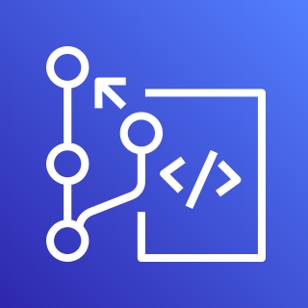
CRUD Operations (detailed)
AWS Cloud
Lambda Layer
DynamoDB
Create Pipeline Flow
*
Create, FlagDeleted, Get & List Databases
PutItem, GetItem, Query
Database Table
Web App
Upload, Download, List, Columns, FlagDeleted, Metadata & Revert Assets
Database Lambda Functions
Presents results, nav & form controls
PutItem, GetItem, UpdateItem, Query
Assets Table
invokes
Triggers form control event
React
Asset Lambda Functions
PutItem, GetItem, Query
Loads view & passes params
Create, FlagDeleted, Get & List Pipelines
Pipelines Table
Create Pipeline Notebook & Container
Requests URL
Pipelines Lambda Functions
Delete Container, Delete Notebook
User
React Router
Create, Update, FlagDeleted, Get, List & List Executions Workflows
PutItem, GetItem, UpdateItem, Query
returns results
Workflows Table
Create StateMachine, List Executions, Delete StateMachine
ECR
uses
Route + Payload
Workflow Lambda Functions
VAM API Service
Amplify JS Library
Results
S3 Select Query, PutObject (change storage class)
VAMS Client API API Gateway
SageMaker
*
*
Upload & Download Assets
*
S3 Asset Bucket
StepFunctions
See Asset Management, Pipeline Creation, and Workflow Creation for breakdown

Slide 8

CRUD Operations – v2
AWS Cloud
Lambda Layer
DynamoDB
Create Pipeline Flow
*
ABAC/
RBAC Tables
Web App
^
Authorization Lambda Functions
Presents results, nav & form controls
Database Tables
invokes
Database Lambda Functions
Triggers form control event
React
Assets Tables
Loads view & passes params
Asset Lambda Functions
Requests URL
User
React Router
Pipelines Tables
SNS
returns results
Route + Payload
Pipelines Lambda Functions
uses
VAM API Service
Workflows Tables
Amplify JS Library
Results
VAMS Client API API Gateway
Workflow Lambda Functions
*
*
Upload & Download Assets
^
Authorization Functions Additionally Used by All Lambdas for Action Approvals
S3
Asset Bucket
Step
Functions
Lambda
*
OpenSearch
See Asset Management, Pipeline Creation, and Workflow Creation for breakdown

Slide 9
CRUD Operations – v2 (detailed)
AWS Cloud
Lambda Layer
DynamoDB
Create Pipeline Flow
Create, Update, Delete, Get, List Authorizations
*
PutItem, GetItem,
UpdateItem, Query
ABAC/
RBAC Tables
Web App
^
Authorization Lambda Functions
Create, FlagDeleted, Get & List Databases
PutItem, GetItem, Query
Presents results, nav & form controls
Database Tables
invokes
Upload, Download, List, Columns, FlagDeleted, Metadata & Revert Assets
Database Lambda Functions
Triggers form control event
React
PutItem, GetItem, UpdateItem
Assets Tables
Loads view & passes params
Query
UpdateIndex
Asset Lambda Functions
CreateTopic, DeleteTopic,
Subscribe, Publish
Requests URL
User
React Router
Create, FlagDeleted, Get & List Pipelines
PutItem, GetItem, Query
Pipelines Tables
SNS
returns results
Create Pipeline Lambda
Route + Payload
Pipelines Lambda Functions
Delete Lambda
uses
Create, Update, FlagDeleted, Get, List & List Executions Workflows
PutItem, GetItem, UpdateItem, Query
VAM API Service
Workflows Tables
Amplify JS Library
Results
VAMS Client API API Gateway
S3 Select, PutObject
(change storage class)
Create StateMachine, List Executions,
Delete StateMachine
Workflow Lambda Functions
*
*
Upload & Download Assets
^
Authorization Functions Also Used by All Lambdas for Action Approvals
S3
Asset Bucket
Step
Functions
Lambda
*
OpenSearch
See Asset Management, Pipeline Creation, and Workflow Creation for breakdown

Slide 10



Asset Management
AWS Cloud
Create Asset
API
Gateway
Assets Lambda Functions
New Item
Assets DynamoDB
Table
Download Asset
Upload New Version
Get Item
Update Asset
Update Item
User
Delete Asset
Change Partition Key
Upload v1
Download Asset
Execute Use-case Pipeline
*
Use-case
Pipeline
Upload v2
Change Storage Class
Asset S3
Bucket
Download Auxiliary Assets
Upload Pipeline
Assets
Asset Auxiliary S3
Bucket
*
See Asset Visualizer Pipeline for full breakdown

Slide 11
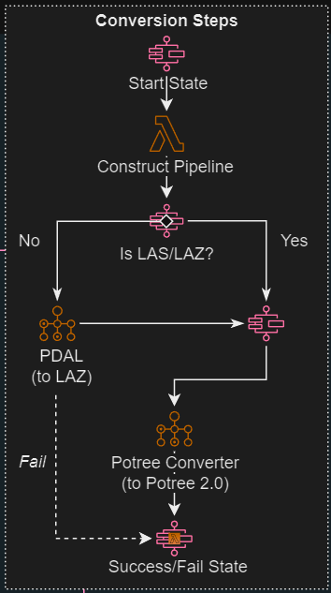

Asset Auxiliary Pipeline (PointCloud Visualizer Example)
AWS Cloud
Notify PointCloud
Asset Upload
Upload Asset
Pipeline Opener
Lambda
Asset S3
Bucket
SNS
User
Download Auxiliary Asset
Construct Pipeline
Lambda
Download
Asset
Batch
Orchestration
Fargate Container
Execution
Pipeline
Step Functions
Upload Auxiliary
Assets
Close
Pipeline
Lambda
Asset Auxiliary S3
Bucket

Slide 12
Pipeline Creation
AWS Cloud
1. New Item
Pipelines
DynamoDB Table
API
Gateway
Pipelines Lambda Functions
Create New Pipeline
Content Management or Data Science User
2. Link Use-case Pipeline Lambda
Lambda
Pipeline Lambda
Create Use-Case Pipeline Lambda
Engineering User

Slide 13



Workflow Creation & Execution
AWS Cloud
Create Workflow
API
Gateway
Workflows Lambda Functions
New Item
Get Workflow
Get Item
Workflows DynamoDB Table
Update Workflow
Update Item
User
Execute Workflow
Create StateMachine
Asset S3 Bucket
StepFunctions
Asset Object
Asset Object
Asset Object
Asset Object
Execute StateMachine
Workflow StateMachine
Pipeline
Container
Pipeline
Container
Pipeline
Container

